Slide 1
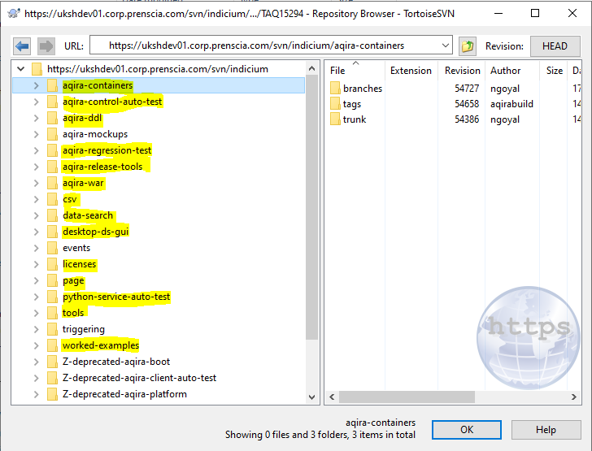
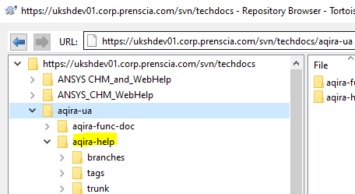
Aqira SVN Repositories
SVN:

Slide 2
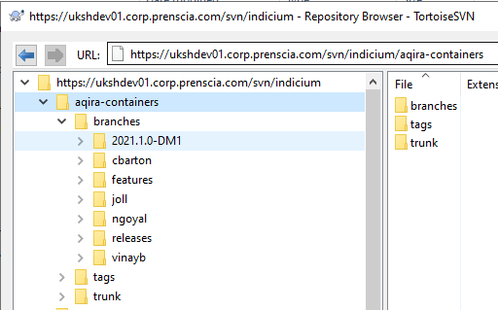
Aqira SVN Repositories
SVN:
Trunk branch for main code
Developers create separate branches from trunk branch to work on user story within branches directory corresponding to their name directory
The trunk code is cloned to releases directory at the time of release.

Slide 3
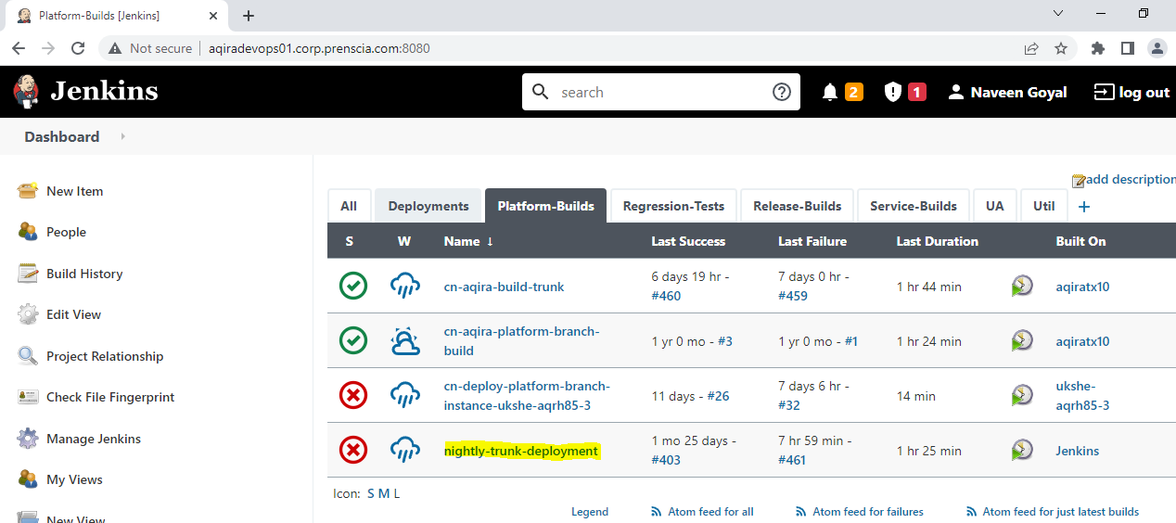
Jenkins Nightly trunk build job

Slide 4
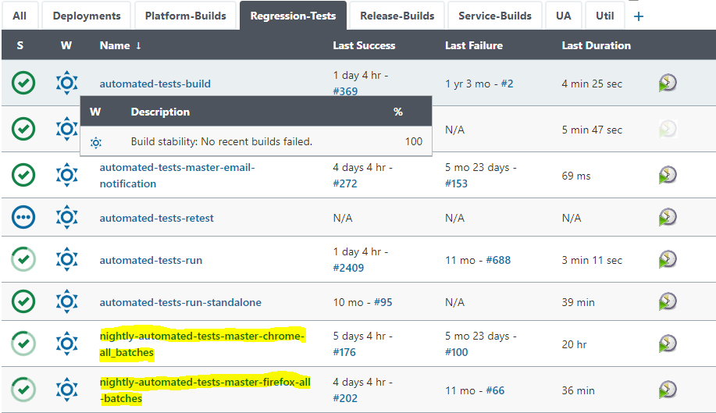
Jenkins Regression Tests Job

Slide 5
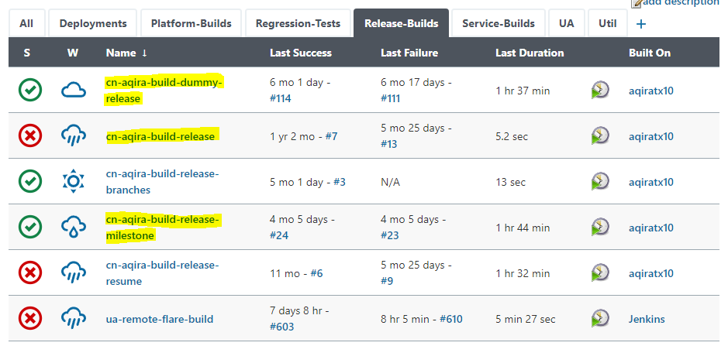
Aqira Release process
We mainly follow the below document for the Aqira release process
https://confluence.hbkworld.com/display/NCODESPACE/Aqira+Release+Process
We create a dummy release to ensure everything is working fine before the actual release
If there is an error/addition/update to the dummy release/release we make the changes to the release branch and after the release we merge it to the trunk branches

Slide 6
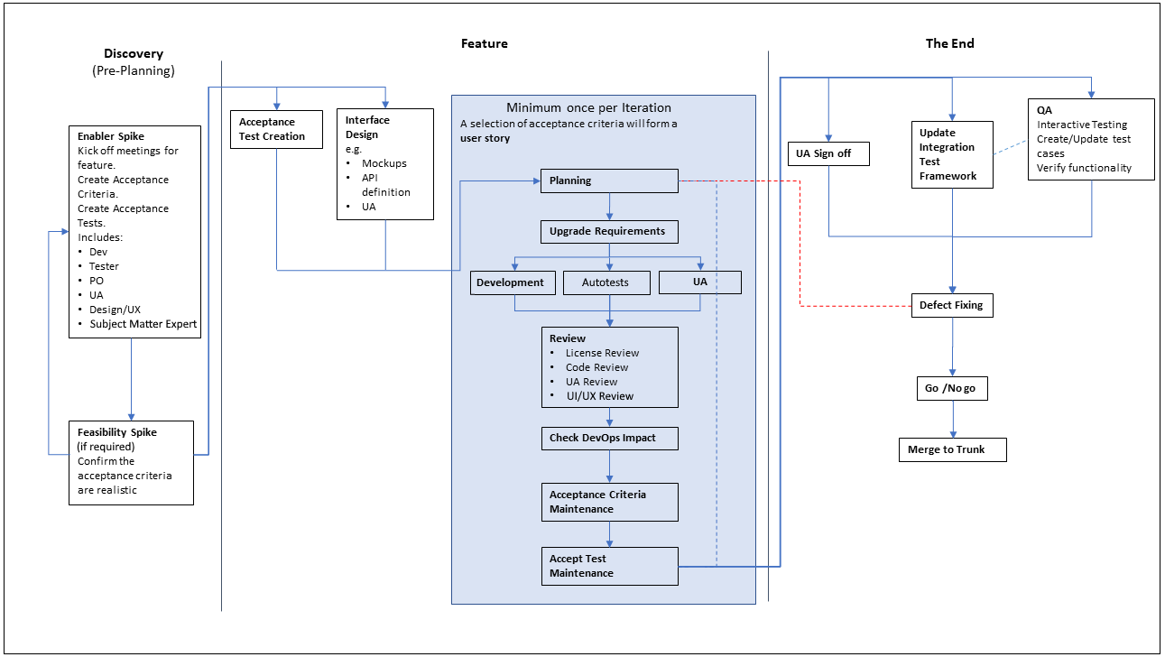
Aqira Development Process

Slide 7
Important Confluence links
Aqira Development Process:
https://confluence.hbkworld.com/display/NCODESPACE/Aqira+Development+Processs
Aqira Release process:
https://confluence.hbkworld.com/display/NCODESPACE/Aqira+Release+Process
Aqira Infrastructure:
https://confluence.hbkworld.com/display/NCODESPACE/Aqira+Infrastructure
Environment information:
https://confluence.hbkworld.com/display/NCODESPACE/Container+Environment+Information
Important Aqira Services
https://confluence.hbkworld.com/display/NCODESPACE/Important+Services

